Slide 1
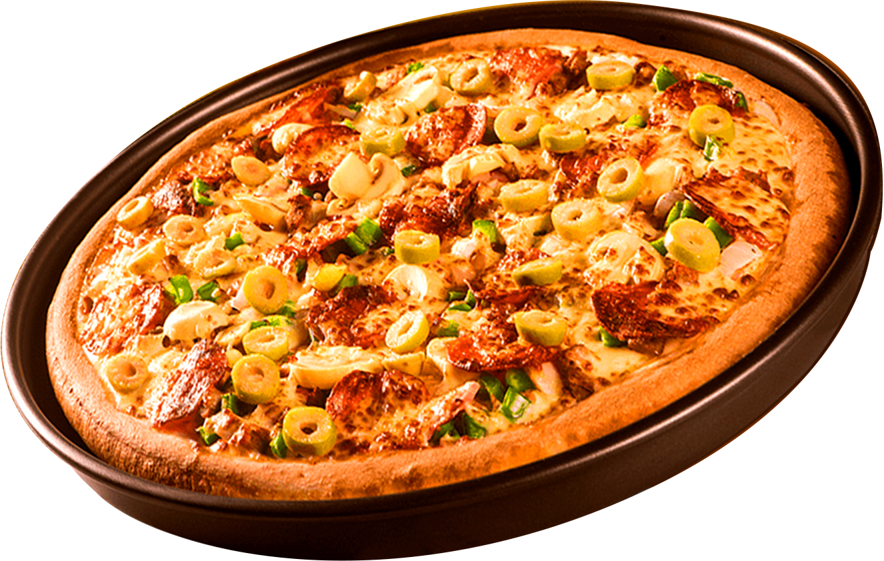


About the Project
Pizzahut
Where Every Slice is a Taste of Perfection
Analyze sales trends
Identify customer favourites
Check revenue insights
Improve operations
Enhance customer satisfaction

Slide 2

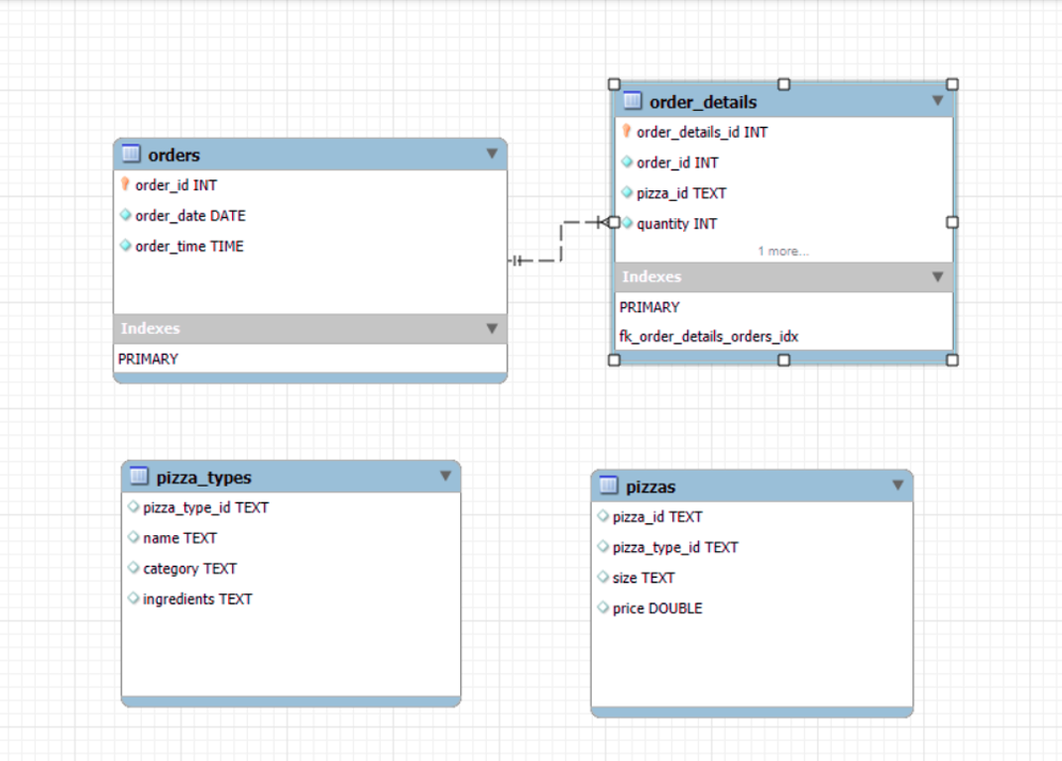
ER Diagram

Slide 3
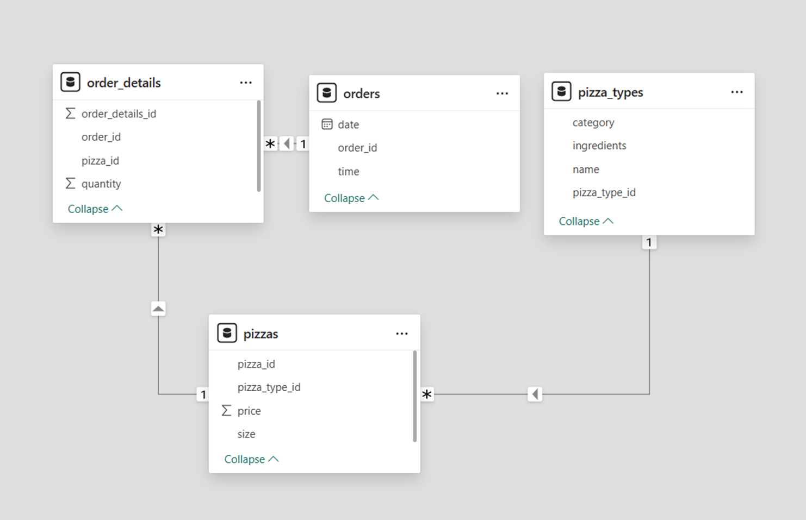
Schema

Slide 4
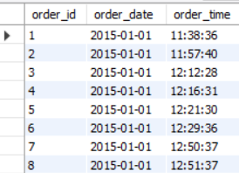
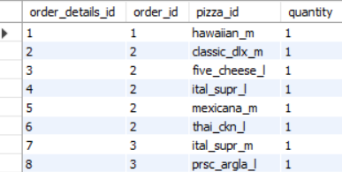
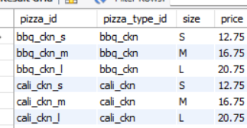
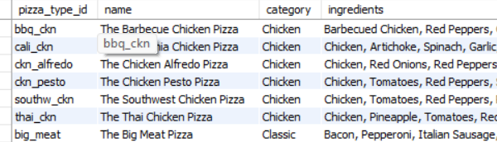
Table View
ORDERS
ORDERS_DETAIL
PIZZAS
PIZZA_TYPES

Slide 5
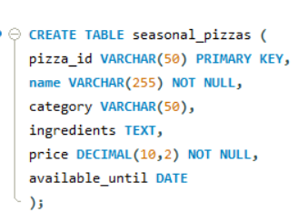
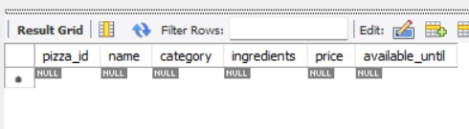
How do we create a new table for limited-time seasonal pizzas?
DDL

Slide 6
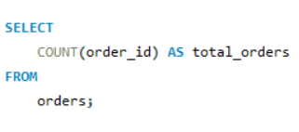
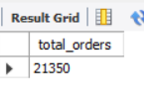
Retrieve the total number of orders placed.

Slide 7
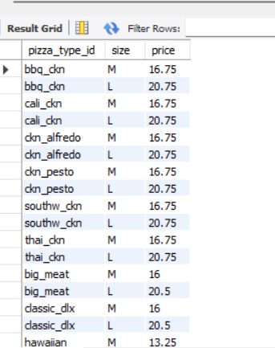
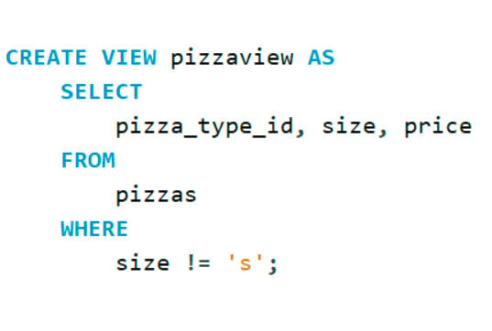
Views
Create a view named pizzaview that retrieves the pizza_type_id, size, and price from the pizzas table, excluding rows where the size is "S".

Slide 8
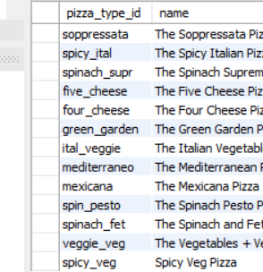
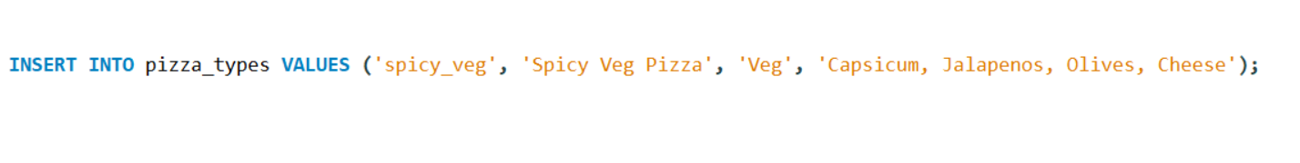
How do we add a new pizza type to our menu?
DML

Slide 9
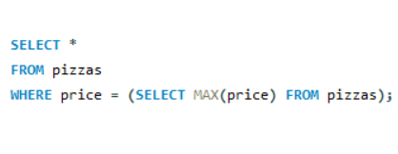
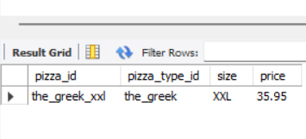
Finding the most expensive pizza
SUB QUERY

Slide 10
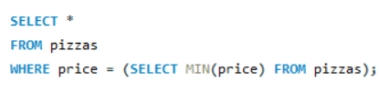
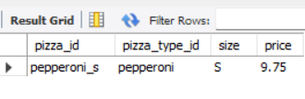
Finding the least expensive pizza

Slide 11
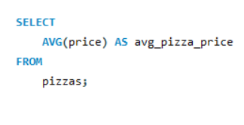
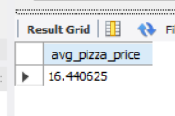
Find the average price of all pizzas

Slide 12
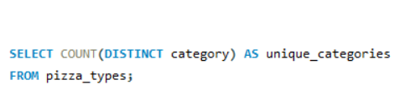
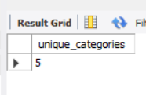
How many unique pizza categories are available on the menu?

Slide 13
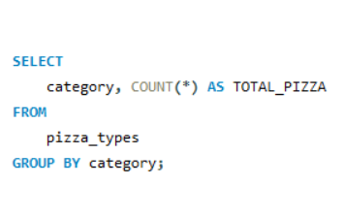
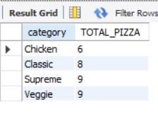
Find category wise distribution of pizzas.

Slide 14
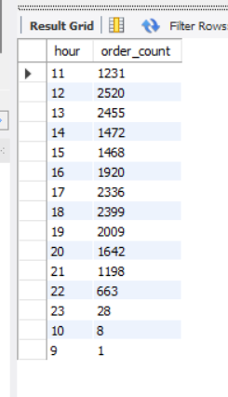
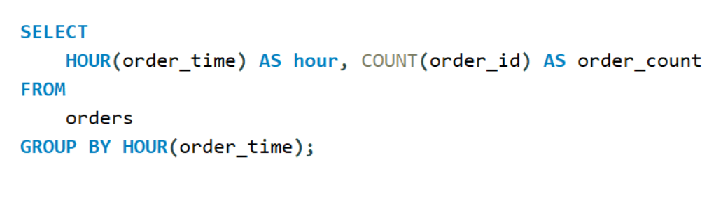
Determine the distribution of orders by hour of the day.

Slide 15
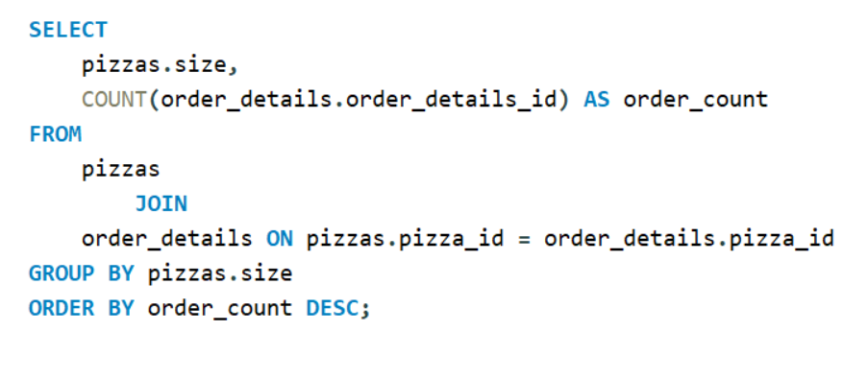
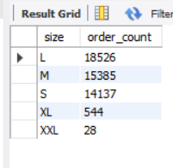
Identify the most common pizza size ordered.

Slide 16
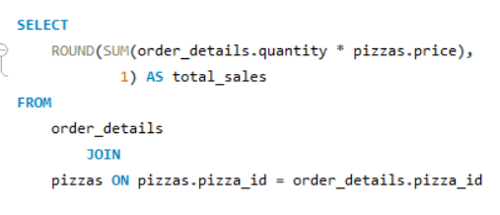
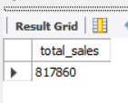
Calculate the total revenue generated from pizza sales.
Joins

Slide 17
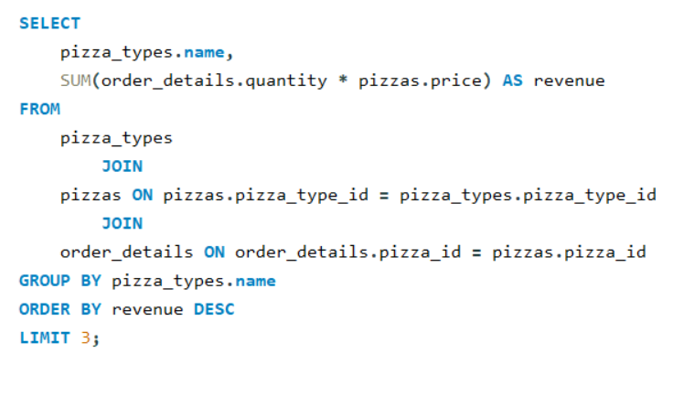
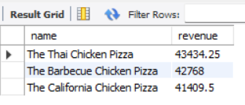
Determine the top 3 most ordered pizza types based on revenue.

Slide 18



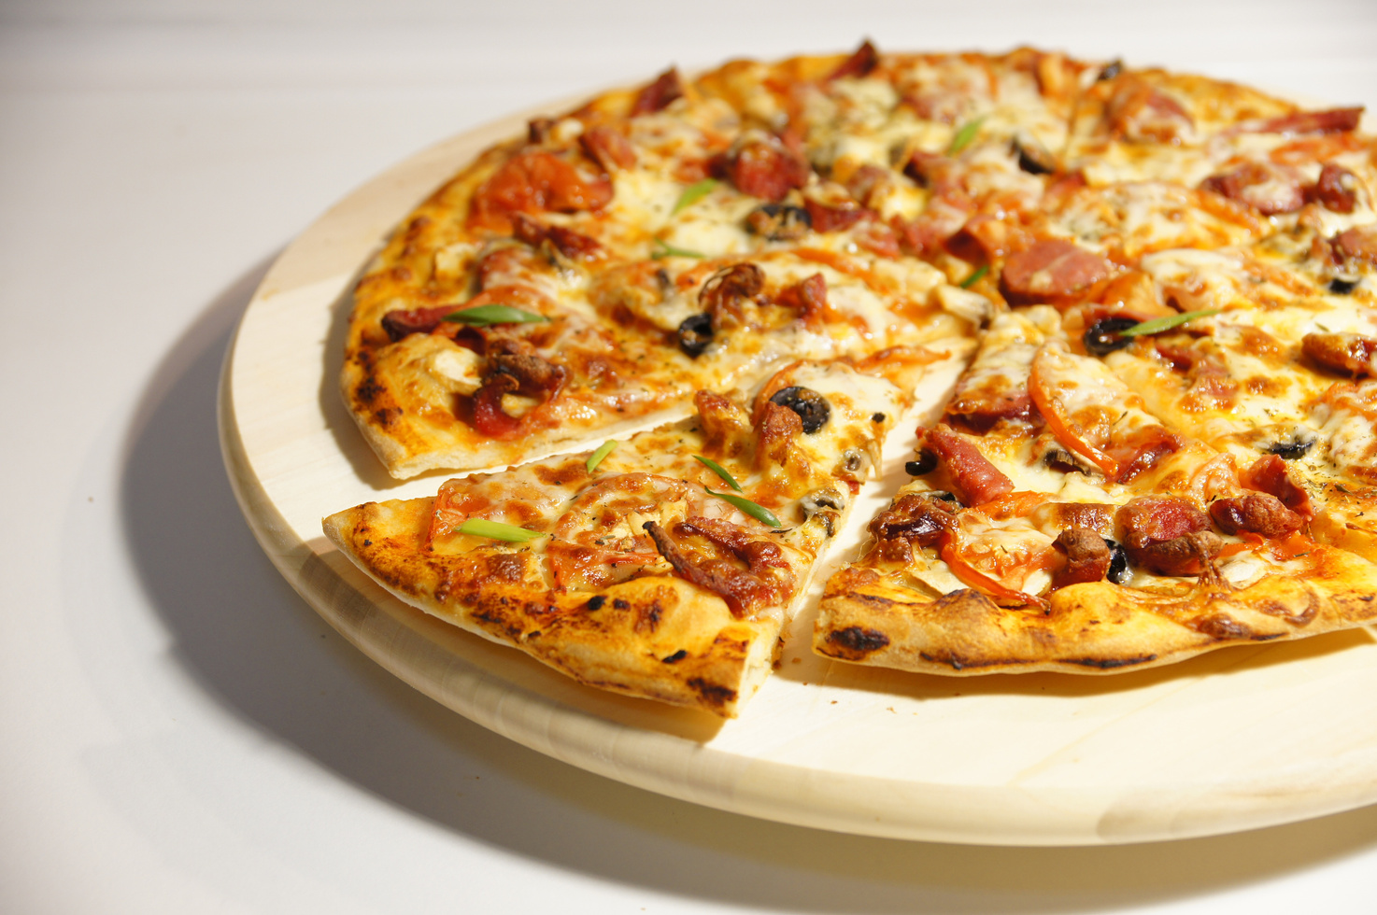
OUR SIGNATURE PIZZAS
Thai Chicken Pizza
The Barbeque Chicken Pizza
The Calfornia Pizza

Slide 19
Conclusion
Optimize menu & pricing
Attract with deals & specials
Improve inventory management
Adapt to customer preferences
Ensure growth with market analysis

